Slide 1
Prey-Predator Coexistence
M. Göksu Öztürk Evolutionary Dynamics

Slide 2
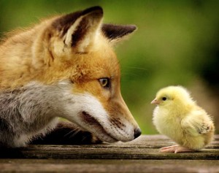
Introduction
Coexistence of species in a closed system
Predation interaction
Predator feeds on its prey
Aggressive predators
Small additional properties in environment

Slide 3
Introduction
Additional features for agents
Many combinations, many simulations
Observe effect of parameters on survival
Explain survival of preys in long run

Slide 4
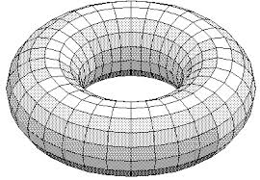
Model
Hard to explain analytically
Too many parameters and non-linearity
Agent-based Modeling
Independent, autonomous agents
Common in complex systems, evolutionary programming
Torus-shaped and grid map
No walls, border etc.
Initialization of agents
Random
Equal in number

Slide 5
Model
Changing every parameter is costly
Some parameters are kept constant
Population size
Duration of each simulation
Vision range and angle
Fitness of both species
Written in Python
Visual environment for testing properties
Black: predator
White: prey

Slide 6
Model
Variable parameters
Map size
Speed and stamina(duration)
Camouflage area size
Warning mechanism(On, Off)
Trapping mechanism(On, Off)
One simulation for each combination

Slide 7
Major Parameters
Warning Mechanism
Warning signal of a predator
Hardly effective during chase
Camouflage
Preys are not seen by predators in specific areas
Predators keep chasing if locked on
Camouflaged in yellow area

Slide 8
Major Parameters
Trap Mechanism
Preys can leave a trap behind with probability Unless they are being chased
Predators die if they touch a trap
Red: trap

Slide 9
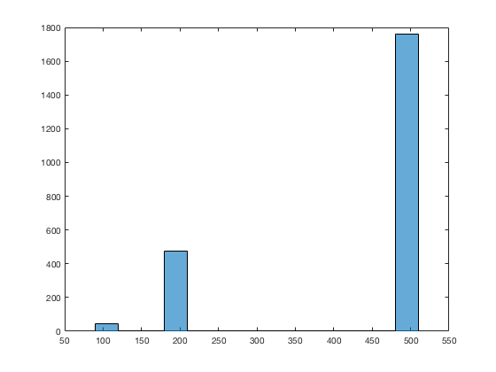
Results
All the results are examined
Equilibria are filtered(freq btw 0.4-0.6)
Impact of parameters are inspected for equilibria
Histogram for each parameter
Map area size has the biggest effect
Less encounter
Better for defensive agents

Slide 10
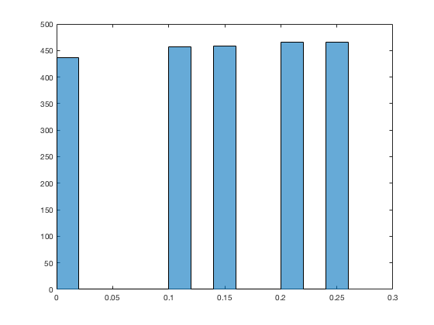
Results
Camouflage
Consistent but small contribution while increasing percentage
Percentage of camouflage area histogram
Initial jump then decay

Slide 11
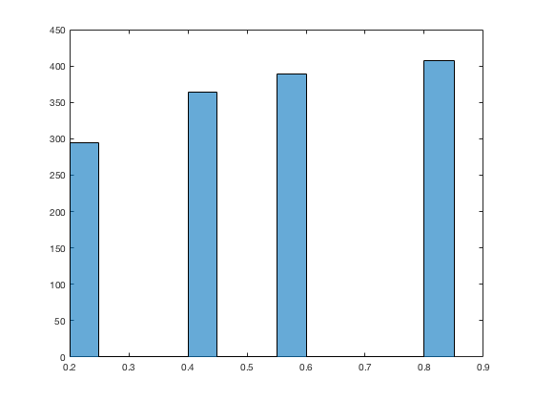
Results
Trap Mechanism
~70% of all equilibria have trapping
Visible positive correlation with percentage

Slide 12
Results
Communication has no effect
Preys can’t benefit from it for alertness
Even though signaling is implemented high level(position of predator)
Stamina has no visible effect
It might make a difference for large maps
More evidence is needed for a solid statement
Parameters as pairs
Big area size is bad for
Offensive skills(chasing, trapping)
Big area size is good for
Defensive skills(running, camouflage)

Slide 13
Restrictions and Future Work
Too many parameters
Exponential increase in number of simulations
Low range of parameters
Sparse histograms
Low confidence for suggestions
More than one simulation for each combination
Subsides the effect of randomness
More solid results

Slide 14
Conclusion
Effective parameters
Map size
Trapping mechanism
Camouflage
Ineffective parameters
Communication
Stamina
More area is good for defensive and bad for offensive

Slide 15
QUESTIONS??

